Slide 1


Unity:
Basics
Vicent Selfa
Curs 2020/2021
Notes:
‹#›

Slide 2
Index:
Download and install Unity
Windows
Linux
From the console
From the official Unity website
Creating a new Unity3D project
Basic elements
Scripts
Sounds
Colliders
Tags
Hinge Joint.
A camera following the sphere
A new project: Vulcan
Unity and Git / GitHub
Notes:
‹#›

Slide 3


Documentation
Interesting links:
Unity User Manual
Tutorials
Templates
Assets
Starting the first game
Notes:
‹#›

Slide 4
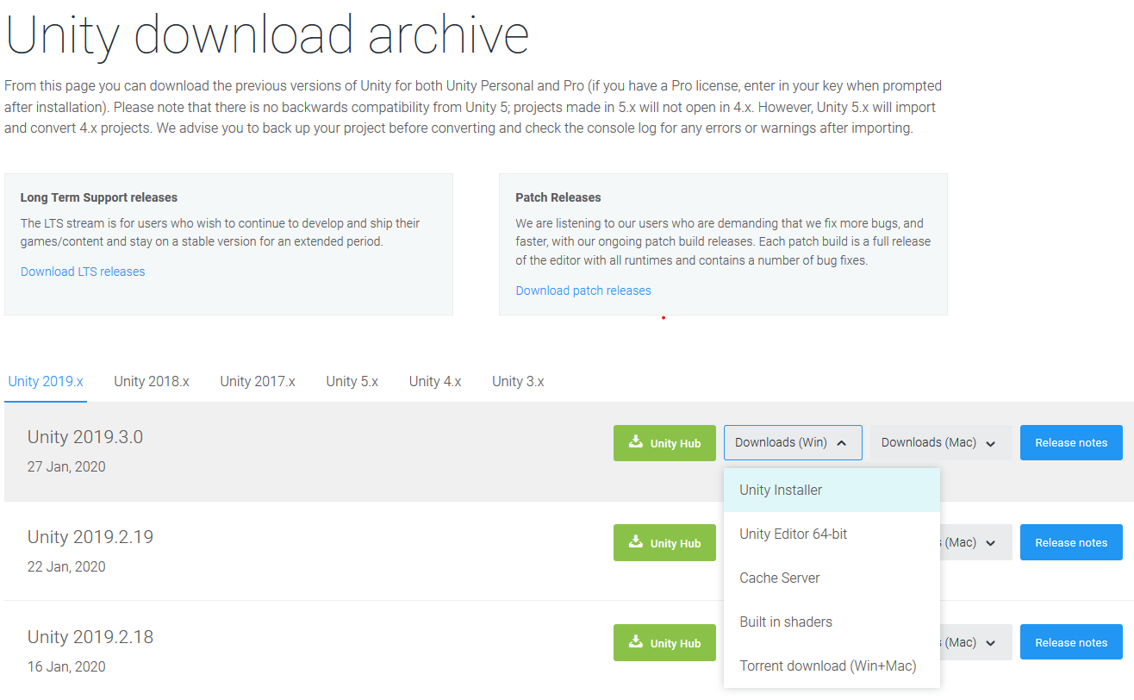
Download and install Unity in Windows
Unity repository
Unity for Mac
Notes:
‹#›

Slide 5
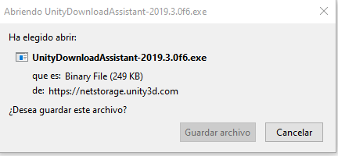
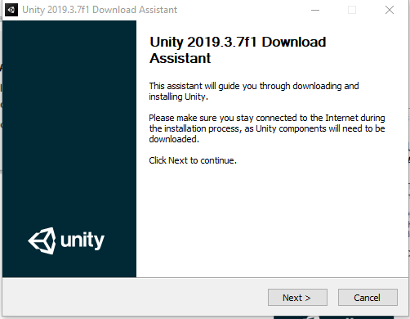
Download and install Unity in Windows
Notes:
‹#›

Slide 6
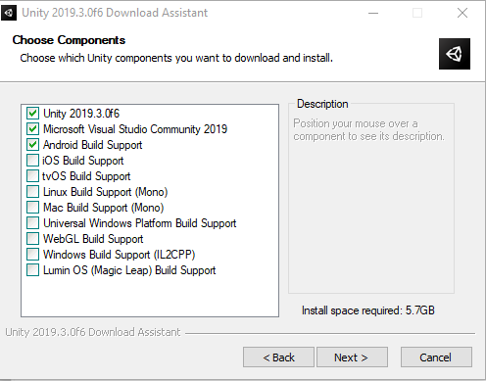
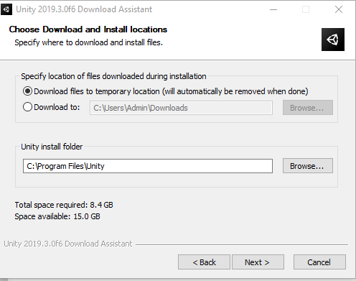
Download and install Unity in Windows
Notes:
‹#›

Slide 7
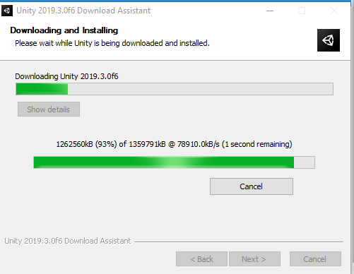
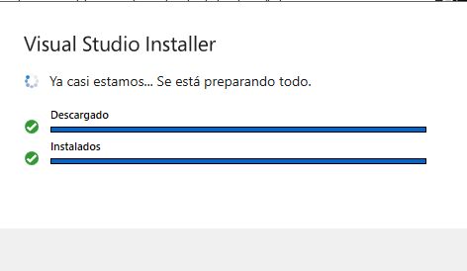
Download and install Unity in Windows
Notes:
‹#›

Slide 8
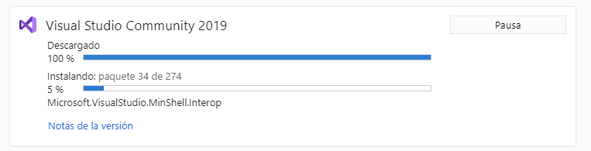
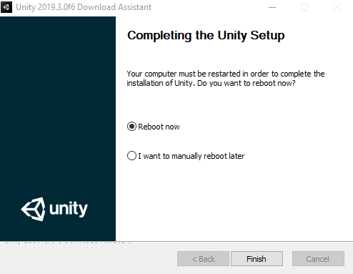
Download and install Unity in Windows
Notes:
‹#›

Slide 9
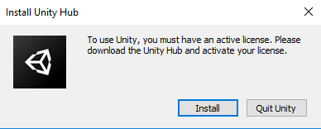
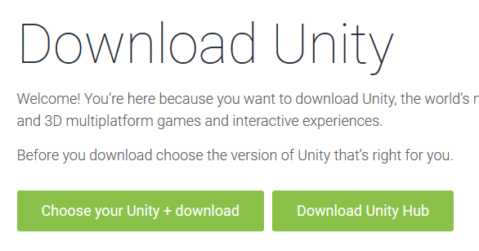
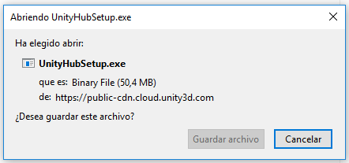
Download and install Unity in Windows
Notes:
‹#›

Slide 10
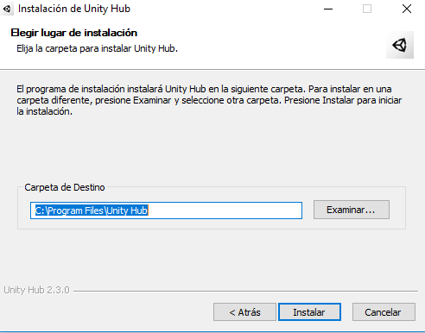
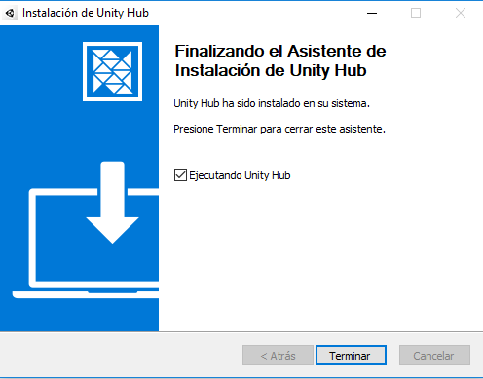
Download and install Unity in Windows
Unity repository
Notes:
‹#›

Slide 11
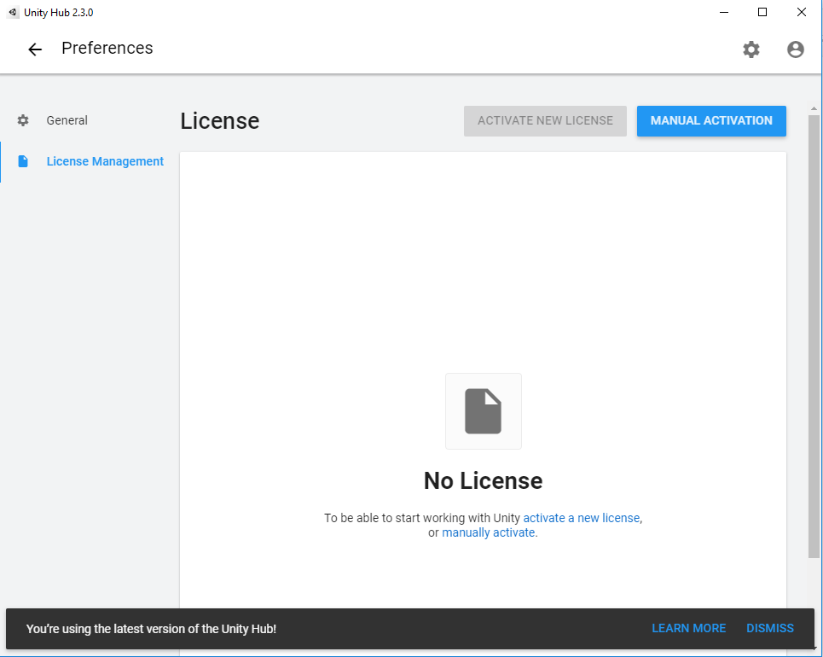
Download and install Unity in Windows
Notes:
‹#›

Slide 12
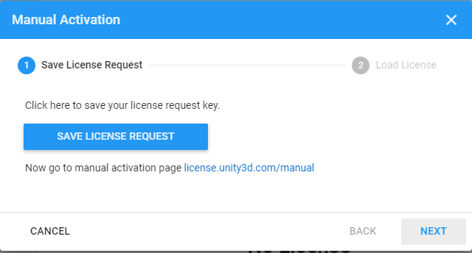

Download and install Unity in Windows
Notes:
‹#›

Slide 13
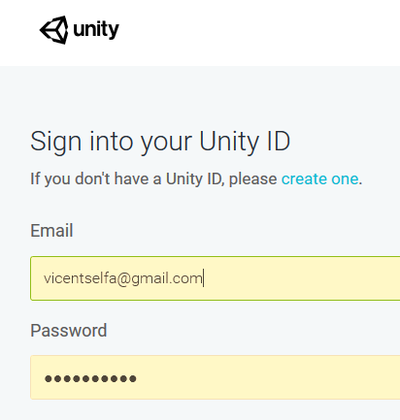
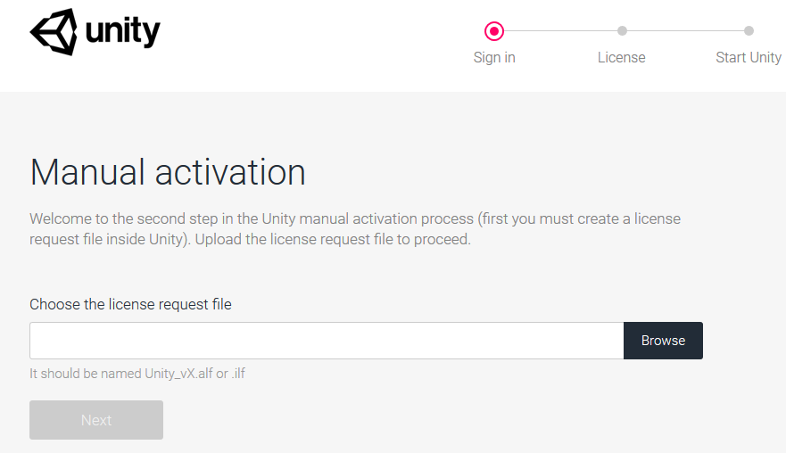
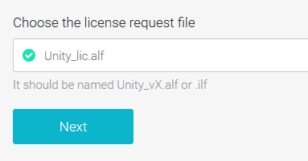
Download and install Unity in Windows
Notes:
‹#›

Slide 14

Download and install Unity in Windows
Notes:
‹#›

Slide 15
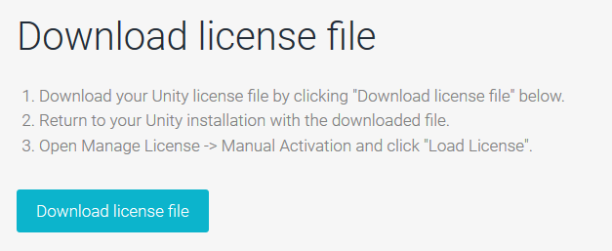
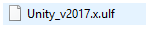
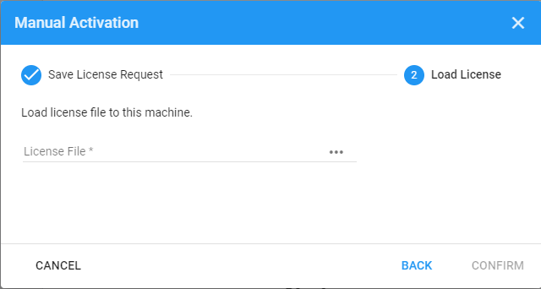
Download and install Unity in Windows
Notes:
‹#›

Slide 16
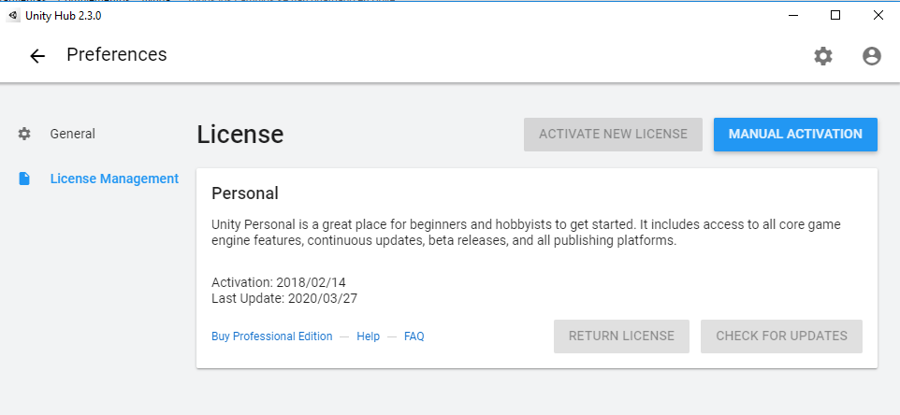
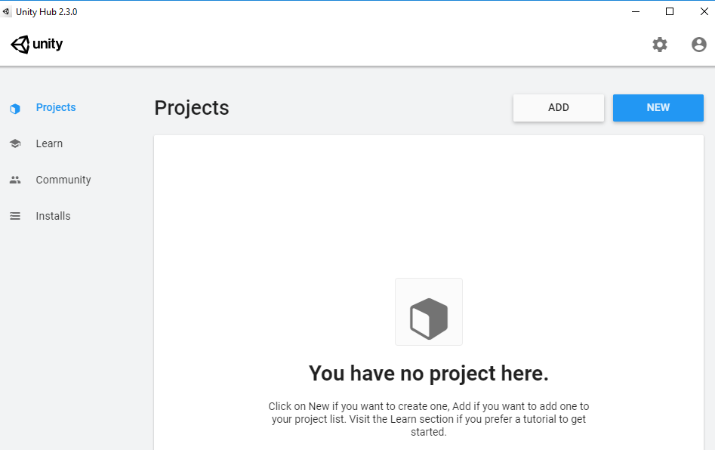
Download and install Unity in Windows
Notes:
‹#›

Slide 17
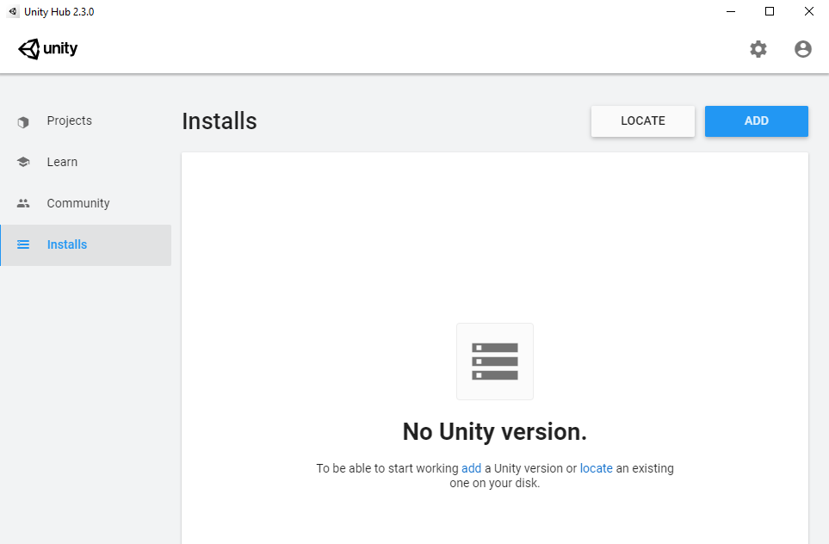
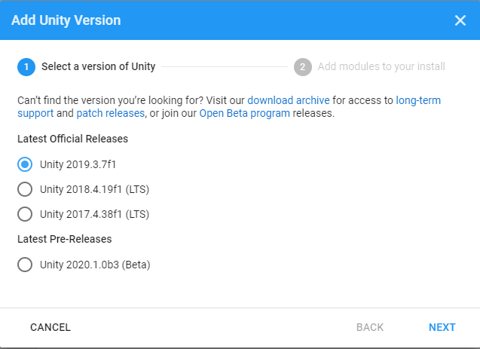
Download and install Unity in Windows
Notes:
‹#›

Slide 18
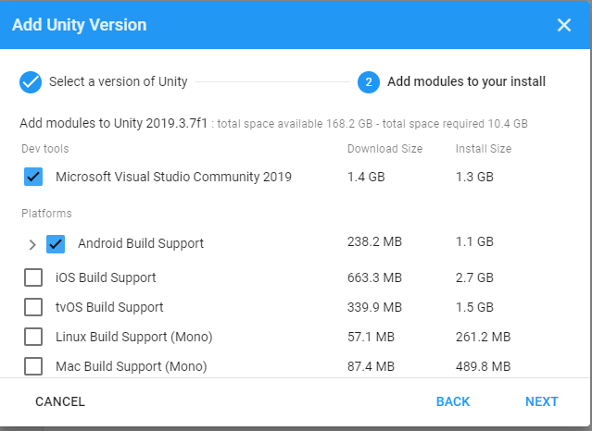
Download and install Unity in Windows
Notes:
‹#›

Slide 19
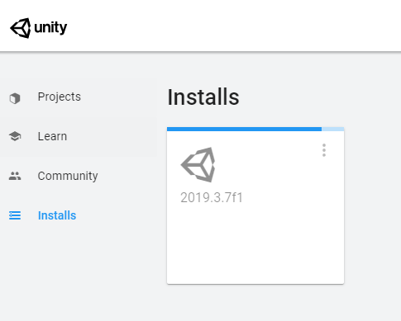
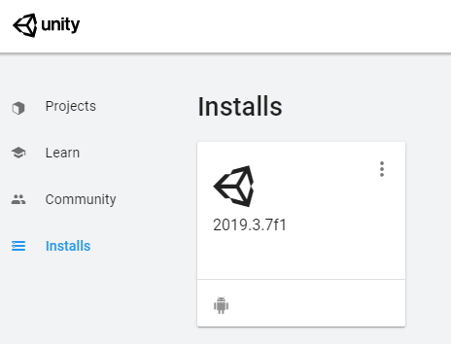
Download and install Unity in Windows
Notes:
‹#›

Slide 20
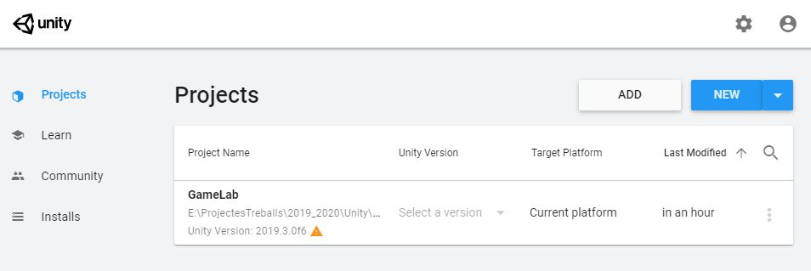
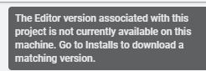
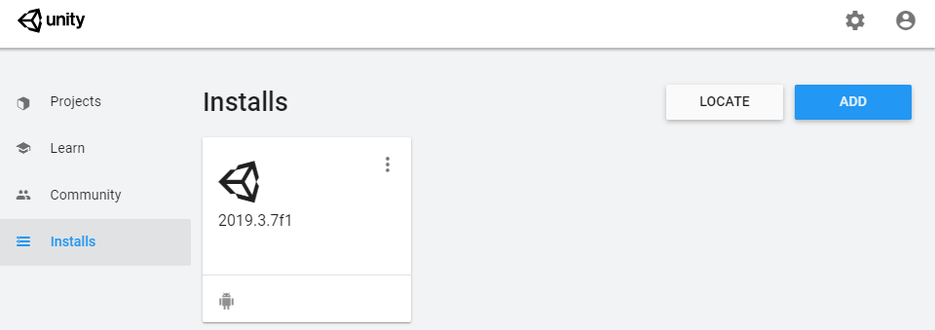
Adding a project in a previous Unity version
Notes:
‹#›

Slide 21
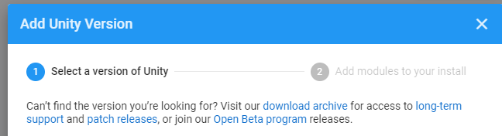

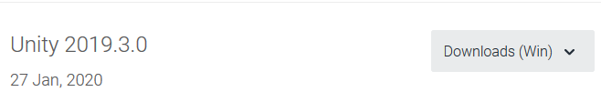
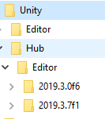
Adding a project in a previous Unity version
Notes:
‹#›

Slide 22
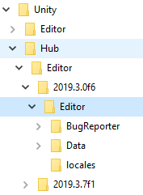
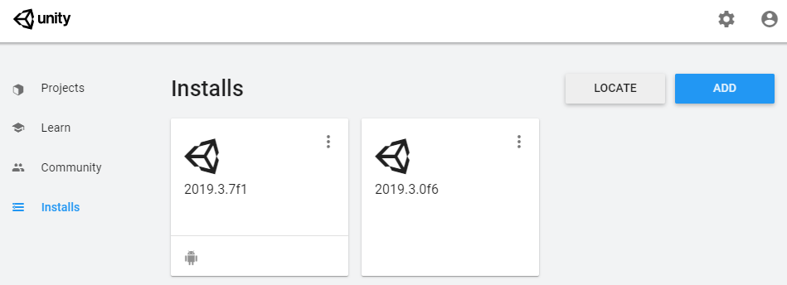
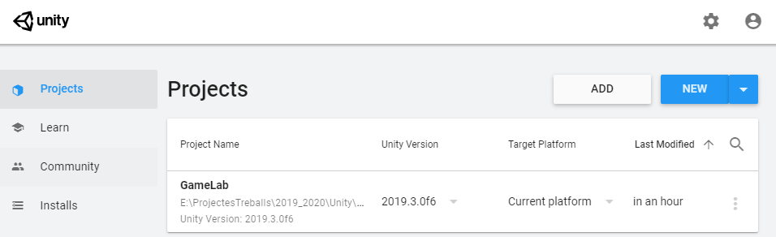
Adding a project in a previous Unity version
Notes:
‹#›

Slide 23


Download and install Unity in Linux
Notes:
‹#›

Slide 24
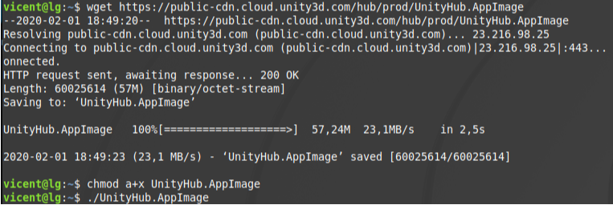
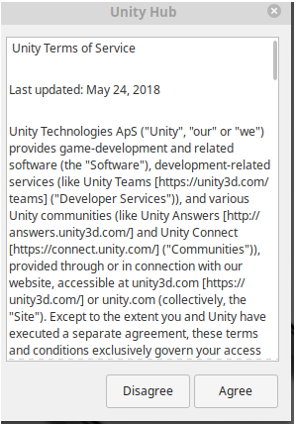
Download and install Unity in Linux (1)
How to install Unity on Linux Mint 19
wget https://public-cdn.cloud.unity3d.com/hub/prod/UnityHub.AppImage
chmod a+x UnityHub.AppImage
./UnityHub.AppImage
Notes:
‹#›

Slide 25
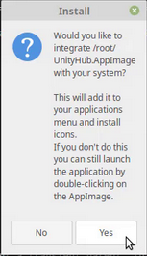
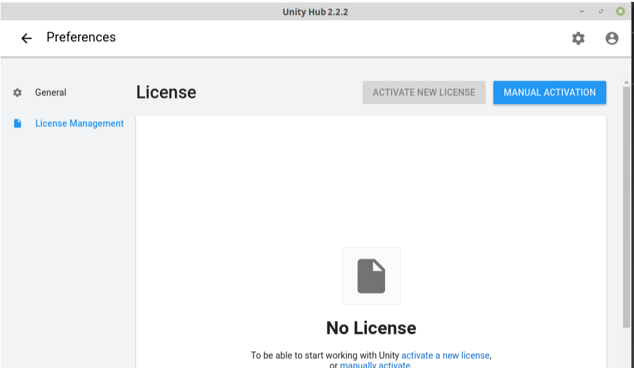
Download and install Unity in Linux (1)
Notes:
‹#›

Slide 26
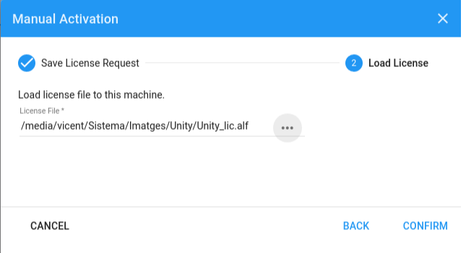
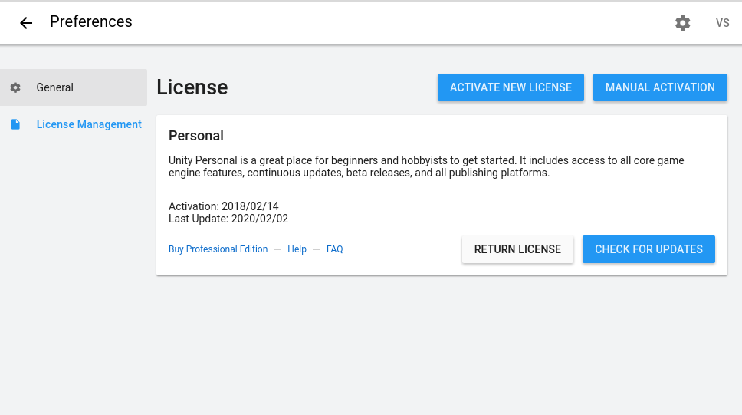
Download and install Unity in Linux (1)
Notes:
‹#›

Slide 27
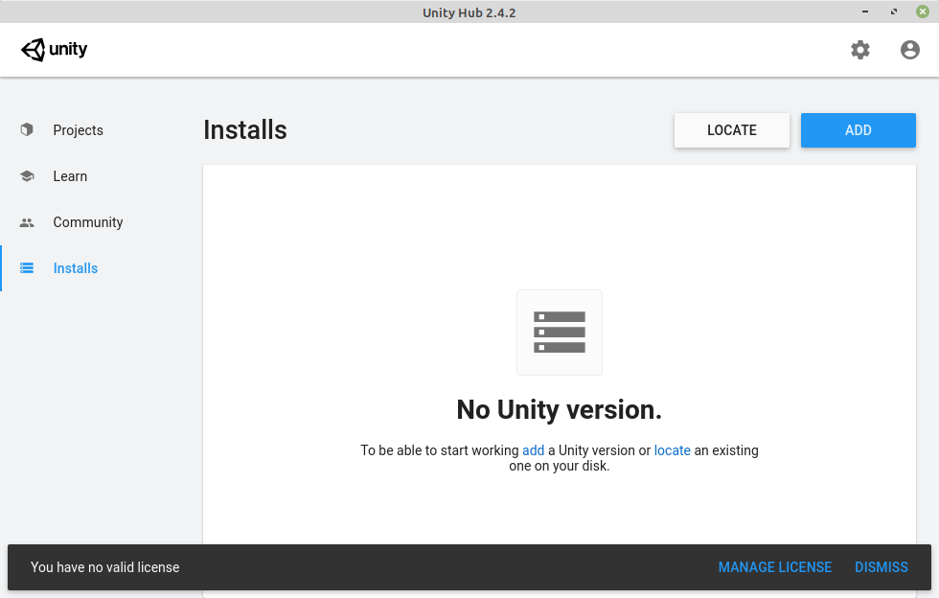
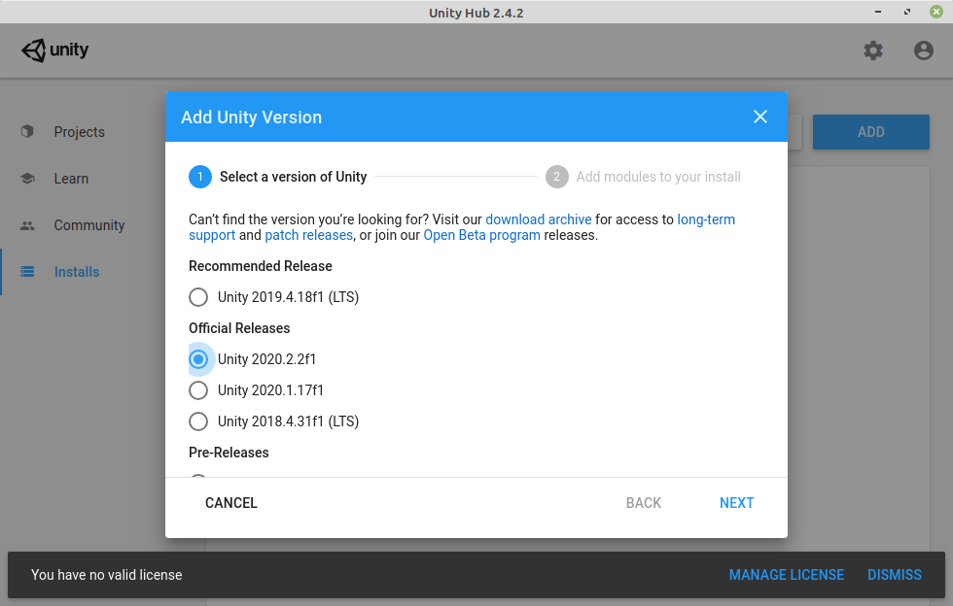
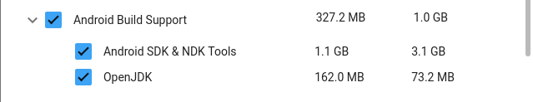
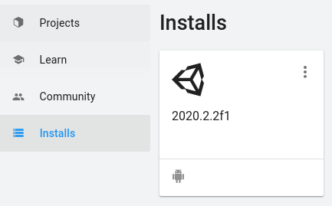
Download and install Unity in Linux (1)
Notes:
‹#›

Slide 28
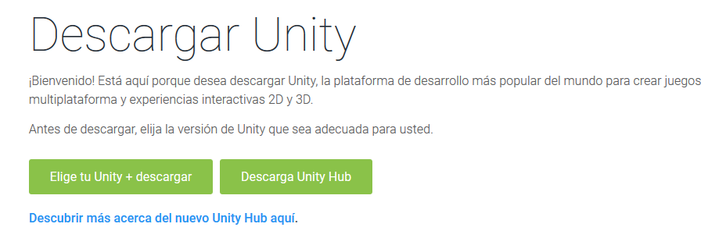
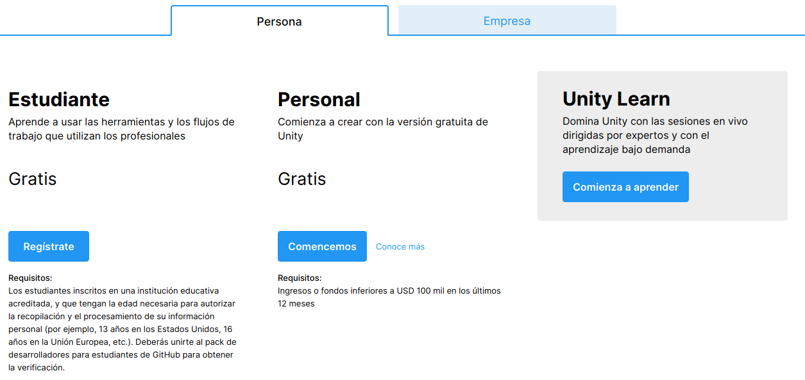
Download and install Unity in Linux (2)
How to install Unity on Linux: From the Unity website
Notes:
‹#›

Slide 29


Download and install Unity in Linux (2)
How to install Unity on Linux: From the Unity website
Notes:
‹#›

Slide 30


Download and install Unity in Linux (2)
How to install Unity on Linux: From the Unity website
chmod a+x UnityHub.AppImage
./UnityHub.AppImage
Notes:
‹#›

Slide 31

Download and install Unity
Managing licenses
Notes:
‹#›

Slide 32


Download and install Unity
Managing licenses
Notes:
‹#›

Slide 33




Download and install Unity in Linux
Notes:
‹#›

Slide 34





Download and install Visual Studio in Linux
Notes:
‹#›

Slide 35



Creating a new Unity project
Notes:
‹#›

Slide 36


Creating a new Unity project
Notes:
‹#›

Slide 37

A new project. Views
Notes:
‹#›

Slide 38





A new project. Layouts
Saving new organization
Organizing views
Notes:
‹#›

Slide 39



A new project. Layouts
Choosing a background theme for the Unity editor
Notes:
‹#›

Slide 40







A new project. Basic elements
Tool bar
Hand
Move
Rotate …
Notes:
‹#›

Slide 41



The plane
Creating a plane for the game
Notes:
‹#›

Slide 42



The perspective
Modifying the perspective of the scene
Other ways of modifying the perspective:
With the wheel of the mouse
Using Alt + left mouse button (Win 10)
Using Alt + arrows keys
Notes:
‹#›

Slide 43






Project folders
Organizing the project using folders
Right button here
Right button
here
Notes:
‹#›

Slide 44



Scenes
Saving the scenes
Notes:
‹#›

Slide 45




Materials
Creating new materials
Right button here
Notes:
‹#›

Slide 46




GameObjects
Creating an sphere
Notes:
‹#›

Slide 47


GameObjects
Spheres with materials
More information here
Notes:
‹#›

Slide 48





GameObjects
Tool bar: Hand, translate, rotate, scale …
Notes:
‹#›

Slide 49


Input Manager
The Input Manager window allows you to define input axes and their associated actions for your Project.
Notes:
‹#›

Slide 50


Scripts
My script editor program: VS Code
Notes:
‹#›

Slide 51



Scripts
My script editor program: VS Code
Configure .NET SDK for Visual Studio code.
Notes:
‹#›

Slide 52




Scripts
My script editor program: Open by file extension (Linux)
Notes:
‹#›

Slide 53





Scripts
Right button here
Notes:
‹#›

Slide 54



Scripts
Move.cs
using System.Collections;
using System.Collections.Generic;
using UnityEngine;
public class Move : MonoBehaviour {
// Use this for initialization
void Start () { }
// Update is called once per frame
void Update () {
// The component Transform of the game object that has the script
transform.Translate(Input.GetAxis("Horizontal"), 0, 0);
}
}
Add the script as a component of the game object
More info about Input.GetAxis here
More information about the class Input here
Notes:
‹#›

Slide 55


Scripts
Running the game
StartStop
Pause
Step by step
Press on the movement keys and say what happens.
The ball moves but it doesn’t fall!!
Notes:
‹#›

Slide 56



Rigidbody
Rigidbody
Motion
Physics engine
The movement is controlled by physical laws
PhysX by nVidia: Graphical engine RigidBody:
Translate, scale, rotation
Tutorials
Notes:
‹#›

Slide 57



Rigidbody
Rigidbody
Run again the game and check what happens.
Notes:
‹#›

Slide 58

Rigidbody
Rigidbody: Applying forces to our game objects
Forces.cs
public class Forces : MonoBehaviour {
public float speed = 2f;
private Rigidbody rigidBody; // 1.- The private variable
// Use this for initialization
void Start () {
// 2.- Accessing to the RigidBody component of the object: Only one time!
rigidBody = GetComponent<Rigidbody>();
}
// Update is called once per frame
void Update () {
// 3.- Using rigidBody every time. Pay attention to the mass of the object!
rigidBody.AddForce(new Vector3 (Input.GetAxis("Horizontal"),
0,
Input.GetAxis("Vertical")
)
);
}
}
Notes:
‹#›

Slide 59

Rigidbody
Rigidbody: Applying forces to our game objects
public float speed = 2f;
Notes:
‹#›

Slide 60

Prefabs
Prefabs
Our goal.- Create something like this: One ball and 4 e
More information here
Notes:
‹#›

Slide 61



Prefabs
Prefabs
A template encapsulating objects. 1.- The object: A cube
More information here
Notes:
‹#›

Slide 62



Prefabs
Prefabs
A template encapsulating objects. 2.- The prefab and the cloned cubs
Delete the previous object and, then, drag and drop from the prefab to create the new objects
Notes:
‹#›

Slide 63


Prefabs
Prefabs
Exercise: Create a prefab side like in the picture
Then create 4 side objects to close the plane
Press on the movement keys and say what happens.
Pay attention: The slides are rigid bodies so they can NOT stay one into the other neither stay out of the plane!!
Notes:
‹#›

Slide 64

Prefabs
Prefabs
Exercise: Create an empty object Borders and put into it the borders.
Notes:
‹#›

Slide 65

Messages: To the console
Showing messages: To the console
public class Move : MonoBehaviour {
// Other attributes
public Text message;
// Other code
void Start () {
// Showing a text into the console
Debug.Log("Starting the game -------------------");
}
}
Notes:
‹#›

Slide 66




Messages: To the scene
Adding text to the scene
A child of Canvas
Notes:
‹#›

Slide 67


Messages: To the scene
showText.cs
Modifying the text from an script
// New includes
using System; // For the class String
using UnityEngine;
using UnityEngine.UI; // For the Text class
public class showText : MonoBehaviour {
// The attribute to control the text
public Text missatge;
// Use this for initialization
void Start () {
// Instantiating the object Text
missatge = GetComponent<Text>();
// Showing a text
missatge.text = "Start";
}
}
More information here
Notes:
‹#›

Slide 68



Messages: To the scene
Modifying the text from an script: Link the attribute with the game object
Notes:
‹#›

Slide 69


Jumping
Jumping using AddForce
public class Jump : MonoBehaviour{
public int jumpValue = 2;
private Rigidbody rigidBody;
// Start is called before the first frame update
void Start() {
// Instantiate the RigidBody component
rigidBody = GetComponent<Rigidbody>();
}
void Update () {
// An impulse (jump), no a constant force. The space bar, by default
// Second condition: To avoid jumping in the air
if (Input.GetButtonDown("Jump") ) { // “Jump” is linked to the backspace key
// Adding force on the y axis: Vector3.up
// Impulse: An instant value for the speed.
rigidBody.AddForce(Vector3.up * jumpValue, ForceMode.Impulse);
}
}
}
// Add Mathf.Abs (rigidBody.velocity.y) < 0.01f as another condition to the if sentence.
// What’s the difference?
Notes:
‹#›

Slide 70

Jumping
Jumping using AddForce
Change the mass and the jump values . What happens?
Notes:
‹#›

Slide 71


Jumping adding text
Adding new messages
using System.Collections; using System.Collections.Generic;
using UnityEngine;
using UnityEngine.UI; // For the Text class
using System; // For the String class
public class Jump : MonoBehaviour {
public int jumpValue = 2; private Rigidbody rigidBody;
// The attribute to control the text
public Text missatge;
// Start is called before the first frame update
void Start() {
rigidBody = GetComponent<Rigidbody>();
ShowText("Ready to jump. Press space bar");
}
void Update () {
if (Input.GetButtonDown("Jump") &&
Mathf.Abs (rigidBody.velocity.y) < 0.01f) {
ShowText("Jumping");
rigidBody.AddForce(Vector3.up * jumpValue, ForceMode.Impulse);
}
}
void ShowText(String aux ) {
missatge.text = aux;
}
}
Notes:
‹#›

Slide 72


Start / stop movement
Start / stop movement using the backspace
public class startStop : MonoBehaviour {
// Public variables
public int jumpValue = 2;
public Text missatge;
public float forceValue = 1;
// Other attributes and methods
}
Notes:
‹#›

Slide 73
Start / stop movement
using System.Collections; using System.Collections.Generic; using UnityEngine;
using UnityEngine.UI; // For the Text class
using System; // For the String class
public class startStop : MonoBehaviour {
private Rigidbody rigidBody; private bool firstBackSpace = true;
public int jumpValue = 2; public Text missatge; public float forceValue = 1;
void Start() {
rigidBody = GetComponent<Rigidbody>();
ShowText("Ready to jump and move. Press space bar and arrow keys");
}
private void Update() {
if (Input.GetButtonDown("Jump")) { // Backspace key
if (firstBackSpace) { // Stop movement
forceValue = 0; rigidBody.drag = 10; firstBackSpace = false;
ShowText("Stop movement"); print("Force value = " + forceValue);
}
else {// Start movement
forceValue = 1; rigidBody.drag = 0; firstBackSpace = true ;
ShowText("Start movement"); print("Force value = " + forceValue);
}
}
// Applying forces to our rígid body
rigidBody.AddForce(new Vector3 (
Input.GetAxis("Horizontal"), 0,Input.GetAxis("Vertical"))*forceValue);
}
void ShowText(String aux ) { missatge.text = aux; }
}
Notes:
‹#›

Slide 74





Sounds: Audio Listener
Adding sound files to our project: The sounds and the folder
The Audio Listener. By default Unity puts an Audio Listener into the camera
Audio with Unity
Notes:
‹#›

Slide 75




Sounds: Audio Listener
Switch off the Audio Listener from the camera
Adding the Audio Listener to the ball. Only ONE audio listener for a project!
Notes:
‹#›

Slide 76

Sounds: Audio Source
Adding Audio Clips into the Audio Sources of the elements
Notes:
‹#›

Slide 77

Sounds: Script
Sounds: Adding Audio Source to actions
public class Boing : MonoBehaviour {
// Other attributes
private AudioSource audioSource;
void Start () {
jumpValue = 10; forceValue = 10f;
// Components
rigidBody = GetComponent<Rigidbody>();
audioSource = GetComponent<AudioSource>();
// Showing a text
ShowText(“Starting …”);
}
void Update () {
if (Input.GetButtonDown("Jump") && Mathf.Abs (rigidBody.velocity.y) < 0.01f) {
ShowText("Jumping");
rigidBody.AddForce(Vector3.up * jumpValue, ForceMode.Impulse);
audioSource.Play();
}
}
// Other methods
}
Notes:
‹#›

Slide 78

Sounds: Script
Sounds: Adding Audio Source to actions
Notes:
‹#›

Slide 79



Tags
The empty objects.
Save the scene and create a new Door scene.
Into the Door scene add:
A plane
An sphere
An empty object filled with 4 sides made using prefabs
A door
Notes:
‹#›

Slide 80





Tags
A way to name and select elements into a script. The borders and door
1.- Add tags
Notes:
‹#›

Slide 81


Tags
Exercise: Add the tag Border to the Prefab side.
Check that ALL the sides get the tag.
Notes:
‹#›

Slide 82


Detecting collisions
OnCollisionEnter method.
Add the next OnCollisionEnter method to your previous script Move.cs
Move.cs
private int numCollisions = 0;
void OnCollisionEnter(Collision other) {
numCollisions++;
Debug.Log("Collision!: " + numCollisions);
}
Exercise: Modify the previous script to show the collisions on the screen.
OnCollisionEnter method
Notes:
‹#›

Slide 83


Detecting collisions
OnCollisionEnter method.
Modify the OnCollisionEnter method in the way:
void OnCollisionEnter(Collision other) {
numCollisions++;
Debug.Log("Collision!: " + numCollisions);
if (other.gameObject.tag == "Door") {
Debug.Log("Collision to the door");
}
}
Exercise: Modify the previous script to show the collisions on the screen.
Also add a Boing sound after each collision.
Notes:
‹#›

Slide 84

Detecting collisions
Exercise
Add a new ball and tag it with ‘WhiteBall’ tag
Add a new material using white colour
Add the new material to the ball
Modify the method OnCollisionEnter(Collision other) in the next way:
void OnCollisionEnter(Collision other) {
// Other text
if (other.gameObject.tag == " WhiteBall ") {
ShowText("Xoc amb la bola blanca!");
Destroy (other.gameObject);
}
}
// What is going to happen?
Exercise: Add more elements to the plane. Try to destroy them making collisions and count them showing the total.
Notes:
‹#›

Slide 85



Communication between objects:
With public variables and FindWithTag
OpenDoor
Notes:
‹#›

Slide 86

Communication between objects:
With public variables and FindWithTag
openDoor.cs
public class openDoor : MonoBehaviour {
private GameObject porta;
private Rigidbody rigidBody;
void Start() { // Get the tag HERE!
rigidBody = GetComponent<Rigidbody>();
porta = GameObject.FindWithTag("Porta");
}
void OnCollisionEnter(Collision other) {
if (other.gameObject.tag == "OpenDoorTag") {
// Open the door
porta.transform.Rotate(0, 90, 0);
}
if (other.gameObject.tag == "CloseDoorTag") {
// Getting the tag to close the door
porta.transform.Rotate(0, -90, 0);
}
}
void Update () {
// To move the ball using arrow keys
transform.Translate(Input.GetAxis("Horizontal"), 0, Input.GetAxis("Vertical"));
}
}
Notes:
‹#›

Slide 87

Communication between objects:
With public variables and FindWithTag
Exercise.-
Add a new game object to close the door
Tag it CloseDoorTag
Modify the OnCollisionEnter method to close the door after a collision with the new element
Notes:
‹#›

Slide 88

Communication between objects:
With public variables and FindWithTag
Notes:
‹#›

Slide 89

Communication between objects:
With public variables and FindWithTag
openCloseDoor.cs
void Start() { // Get the tag HERE!
rigidBody = GetComponent<Rigidbody>();
porta = GameObject.FindWithTag("Porta");
}
void OnCollisionEnter(Collision other) {
if (other.gameObject.tag == “OpenDoorTag") {
// Open the door
porta.transform.Rotate(0, 90, 0);
}
if (other.gameObject.tag == “CloseDoorTag") {
// Getting the tag to close the door
porta.transform.Rotate(0, -90, 0);
}
}
Notes:
‹#›

Slide 90
Communication between objects:
Using SendMessage
Using object.SendMessage (“Name of a method”) will run the method of the object to we send the message: Play an audio source
openCloseDoor.cs
public class Move : MonoBehaviour {
// Other code
private GameObject porta;
void Start() {
porta = GameObject.FindWithTag("Porta");
}
// Update is called once per frame
void Update() { }
void OnCollisionEnter(Collision other) {
if (other.gameObject.tag == “OpenDoorTag") {
porta.transform.Rotate(0, 90, 0);
porta.SendMessage("Play"); // Play the sound
}
if (other.gameObject.tag == “CloseDoorTag") {
porta.transform.Rotate(0, 90, 0);
porta.SendMessage("Play");
}
}
}
public class SoundDoorOpened : MonoBehaviour {
private AudioSource audioSource;
// Start is called before the first frame update
void Start() {
audioSource = GetComponent<AudioSource>();
}
// Update is called once per frame
void Update() { }
void Play () {
audioSource.Play();
}
}
SoundDoorOpened.cs
Notes:
‹#›

Slide 91




Communication between objects:
A camera following the sphere
public class Follow : MonoBehaviour {
// To follow an object keeping an offset distance
public GameObject target; // The object to follow
private Vector3 offset; // The distance
void Start () {
offset = transform.position - target.transform.position;
}
void LateUpdate() {
// To move the camera AFTER the sphere
// keeping always the same distance (offset)
transform.position = target.transform.position + offset;
}
}
Notes:
‹#›

Slide 92


Instantiating objects in a dynamically way
Create a new project: Vulcan
Notes:
‹#›

Slide 93




Instantiating objects in a dynamically way
The empty game object Vulcan
The prefab stone
The folders
Notes:
‹#›

Slide 94




Instantiating objects in a dynamically way
The scripts.-
Eruption into Vulcan
Impulse into Stone
The script: Eruption into Vulcan game object
public class Eruption : MonoBehaviour {
public GameObject stone;
// The frequency of fire
public float fireRate = 0.5f;
// Initial time value
private float nextFire = 0.0f;
// Use this for initialization
void Start () { }
// Update is called once per frame
void Update () {
if (Time.time > nextFire) {
nextFire = Time.time + fireRate;
// Object, position and rotation of the new fire
Instantiate(stone, transform.position, Random.rotation);
}
}
}
More info about Instantiate here
Notes:
‹#›

Slide 95


Instantiating objects in a dynamically way
The script: Impulse into Stone game objecte
public class Impulse : MonoBehaviour {
private Rigidbody rigidBody;
public float forceImpulse = 1.0f;
// Use this for initialization
void Start () {
rigidBody = GetComponent<Rigidbody>();
// The initial impulse to be applied to every stone only // when they are created
rigidBody.AddForce(Vector3.up * forceImpulse,
ForceMode.Impulse);
}
// Update is called once per frame
void Update () { }
}
Notes:
‹#›

Slide 96


Instantiating objects in a dynamically way
The final result
Give a name to the scene and save it.
Notes:
‹#›

Slide 97



Instantiating objects in a dynamically way
A vulcan with colored stones: A new scene with a Plane and a Vulcan.
Add a new ColoredStone prefab and a new ColoredEruption script.
Notes:
‹#›

Slide 98

Instantiating objects in a dynamically way
Randomizing the stone colours
public class ColoredEruption : MonoBehaviour {
// The object
public GameObject stone;
// The color
private Color newColor; private int numColor;
// The renderer
MeshRenderer stoneRenderer;
// The material
Material stoneMaterial;
// Other variables
public float fireRate = 0.5f; private float nextFire = 0.0f;
// Use this for initialization
void Start () { }
// Update is called once per frame
void Update () {
if (Time.time > nextFire) {
nextFire = Time.time + fireRate;
// Object, position and rotation of the new fire
Instantiate(stone, transform.position, Random.rotation);
// Generating the new random color
numColor = Random.Range (1,4); // 1, 2, 3
switch (numColor){
case 1: newColor = Color.blue; break;
case 2: newColor = Color.red; break;
case 3: newColor = Color.yellow; break;
}
// Instantiate renderer
stoneRenderer = stone.GetComponent<MeshRenderer>();
// Instantiate material
stoneMaterial = new Material(Shader.Find("Standard"));
// Add color to material
stoneMaterial.color = newColor;
// Add material to renderer
stoneRenderer.material = stoneMaterial ;
}
}
}
Notes:
‹#›

Slide 99

Instantiating objects in a dynamically way
Randomizing the stone colours
Notes:
‹#›

Slide 100



Instantiating objects in a dynamically way
The last version: A real vulcan.
Importing assets
Notes:
‹#›

Slide 101




Instantiating objects in a dynamically way
The last version: A real vulcan.
My assets
Notes:
‹#›

Slide 102





Instantiating objects in a dynamically way
The last version: A real vulcan.
View the assets
Notes:
‹#›

Slide 103



Instantiating objects in a dynamically way
The last version: A real vulcan.
Notes:
‹#›

Slide 104




Instantiating objects in a dynamically way
The last version: A real vulcan. The Mountain scene
(*) Changed the name Sample scene by MountainScene
Notes:
‹#›

Slide 105




Instantiating objects in a dynamically way
The last version: A real vulcan. The RealStone on the top of the mountain.
Notes:
‹#›

Slide 106


Instantiating objects in a dynamically way
The last version: A real vulcan. The RealStone prefab
Notes:
‹#›

Slide 107


Instantiating objects in a dynamically way
The last version: A real vulcan. Adding components to the Vulcan
Notes:
‹#›

Slide 108


Instantiating objects in a dynamically way
The last version: A real vulcan. Adding components to the RealStone
More info about Mesh Collider and Convex here
Notes:
‹#›

Slide 109


Instantiating objects in a dynamically way
The last version: A real vulcan. Adding sounds
Notes:
‹#›

Slide 110

Instantiating objects in a dynamically way
The last version: A real vulcan with a RealEruption script
public class RealEruption : MonoBehaviour {
public GameObject stone;
private float x0, y0, z0;
private Vector3 initPosition;
public float fireRate = 5f;
private float nextFire = 0.0f; // Initial value
// Use this for initialization
void Start () {
// The top of the vulcan
x0 = 364; y0 = 60; z0 = 370;
initPosition = new Vector3 (x0, y0, z0);
}
// Update is called once per frame
void Update () {
if (Time.time > nextFire) {
nextFire = Time.time + fireRate;
// Object, position and rotation of the new fire
Instantiate(stone, initPosition, Random.rotation );
}
}
}
Notes:
‹#›

Slide 111

Instantiating objects in a dynamically way
The last version: A real vulcan. The final result
Notes:
‹#›

Slide 112


Annex:
Adding Git to the Unity project
Notes:
‹#›

Slide 113
Annex:
Adding Git to the Unity project
Install Git in your computer if you hadn’t done yet. In Linux:
$ sudo apt-get install git-core
# Graphical interfaces
$ sudo apt-get install gitk
$ sudo apt-get install gitg
Go to your working directory:
cd /myWorkingDirectory ;The Unity project folder
Initialize Git: init
git init
Global configuration => file .gitconfig
git config --global user.name “MyGitUserName"
git config --global user.email “MyGitEmail"
git config --global push.default "matching“
The list of Git settings
git config --list
Notes:
‹#›

Slide 114


Annex:
Adding Git to the Unity project
Starting with git: add
git add . ; Adding all the files of the project
The first commit
git commit -m “The first commit of my Assets files”
Showing commits:
gitk
Notes:
‹#›

Slide 115





Annex:
Uploading the Unity project to GitHub
Create a remote repository
Upload the project to the repository: push
git remote add origin https://github.com/vselfa/UnityPMDM2019.git
git push -u origin master
Notes:
‹#›

Slide 116

Annex:
Uploading the Unity project to GitHub
Notes:
‹#›

Slide 117

Annex:
Clone and pull a Unity project from GitHub
; The first time: Create a new folder and use clone command
$ mkdir newFolder ; The first clonne
$ git clone https://github.com/vselfa/UnityPMDM2019.git ./newFolder
$ cd newFolder
$ ls -l
; The next times: Pull command
$ git pull
Notes:
‹#›

